Slide 1


Premio & Dargan Tools
B2B eCommerce in action
Presented by: Brian O’Driscoll, Managing Director, Premio eCommerce
Rich Reddy, Head of Technology, Product Development & Export Strategist, Premio eCommerce
Chris O’Donoghue, Account Manager, Dargan Tools
www.premio.ie

Slide 2


www.premio.ie​
Changing B2B Landscape:
Digital transformation is accelerating in wholesale and distribution.
•Customers expect faster, self-service ordering anytime, anywhere.
•Traditional processes create bottlenecks.
•Younger buyers prefer digital and self-service purchasing.

Slide 3

www.premio.ie​
Introducing Premio: Built for Wholesalers by Wholesalers
Built by a wholesaler who couldn’t find a B2B eCommerce solution that fitted their workflow.
Founded for real B2B needs: pricing, promotions, catalogues,
Who uses Premio: SME wholesalers, typically €5M–€50M turnover
Scale: Hundreds of trade customers, thousands of products/SKUs

Slide 4

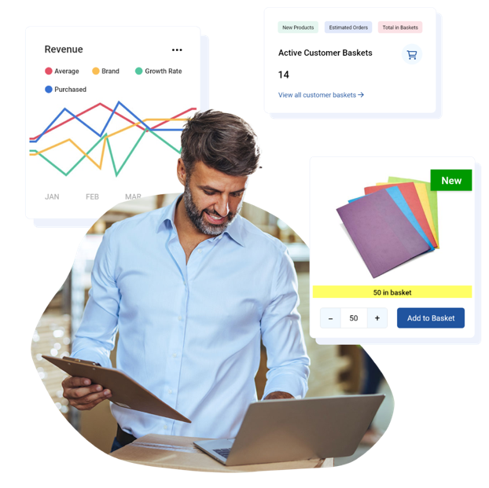
www.premio.ie​
Why Premio Works:
Intuitive platform: B2C-type user experience
Convenience: Always open, 24/7
Speed: Order, bulk order, or reorder in seconds
Customer account specific: Tailored products and pricing
Non-account users: Guest/cash users supported
Local support: Each client’s workflow is slightly different

Slide 5
www.premio.ie​
Features to excite your team
Search
Share List PDF
Multiple Browsing Modes
Catalogue Builder
Account On Hold
Online Payments
Guest Checkout
ERP Integration
Promotions
Send a Quote

Slide 6
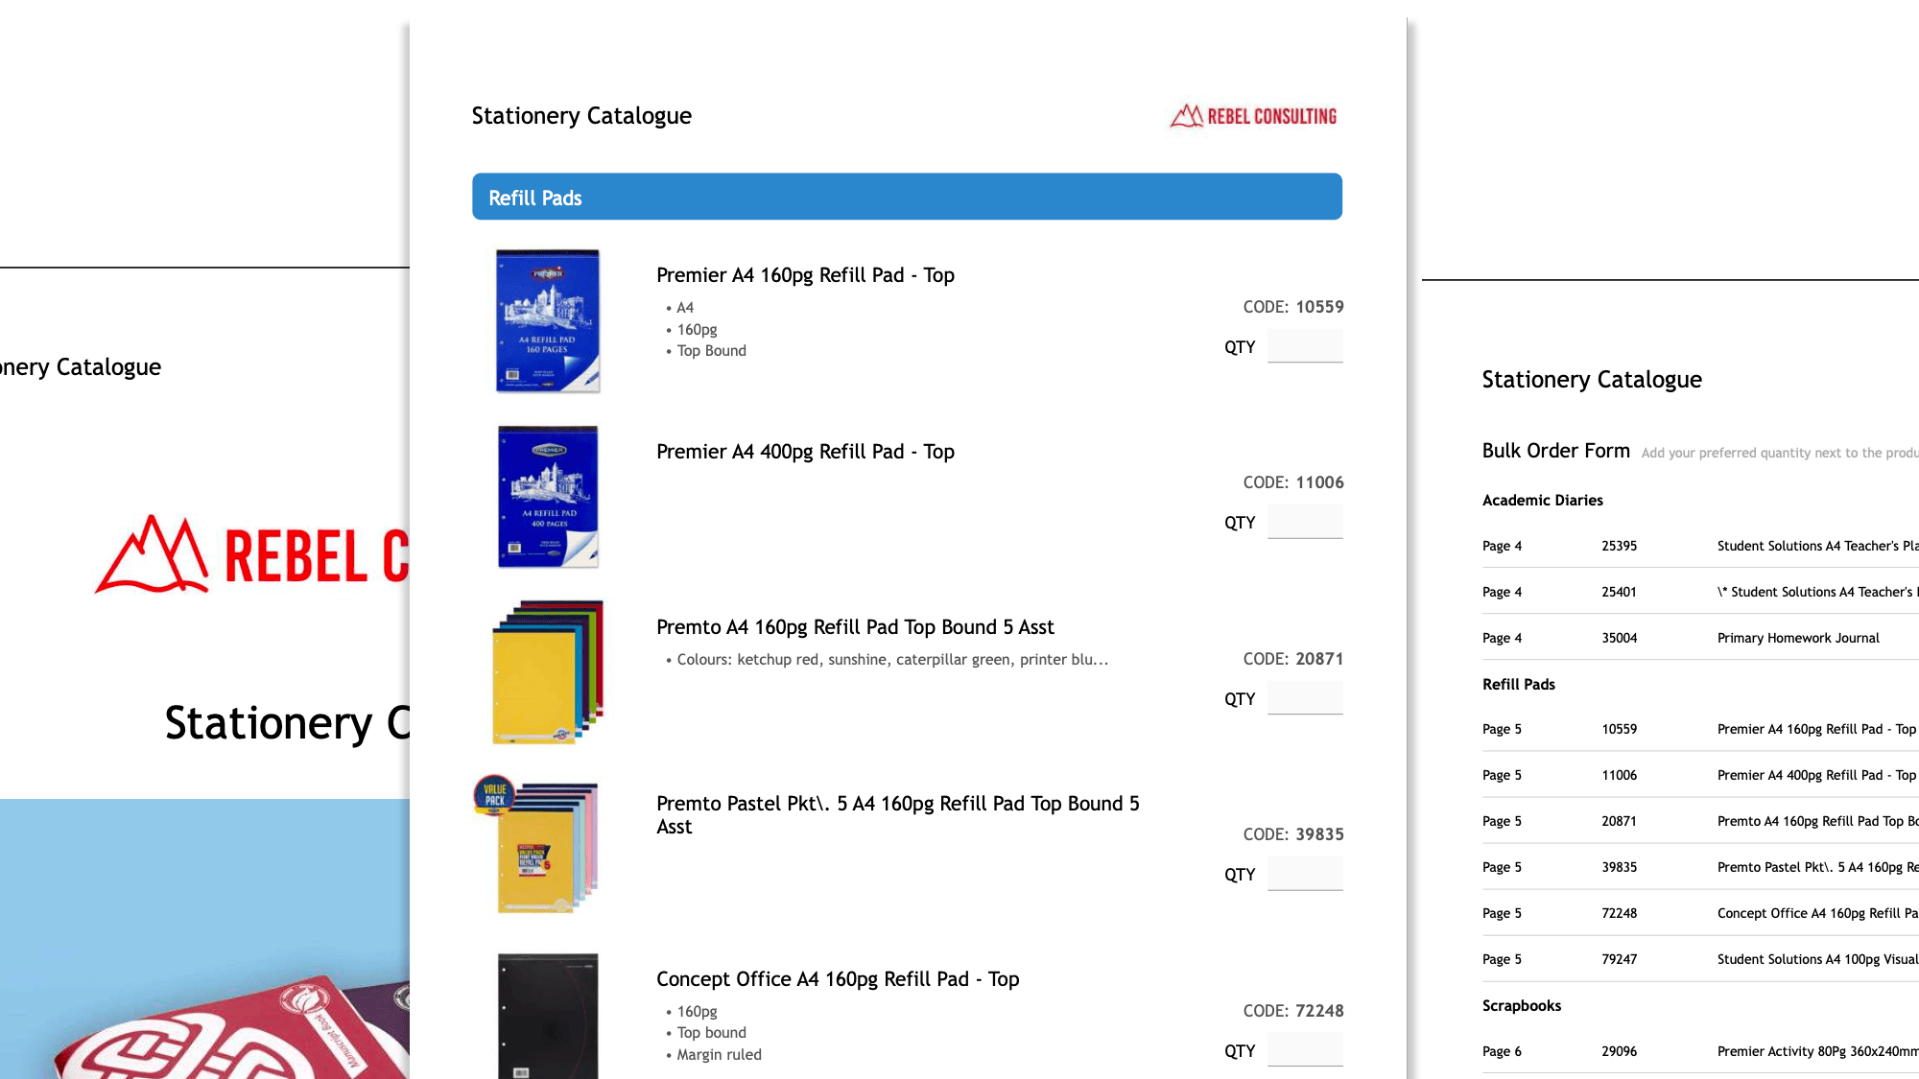
www.premio.ie​
Catalogue Builder
Build catalogues instantly in 5 steps
Uses existing Product data and images OR can be customised
Auto-generated bulk order form and table of contents

Slide 7
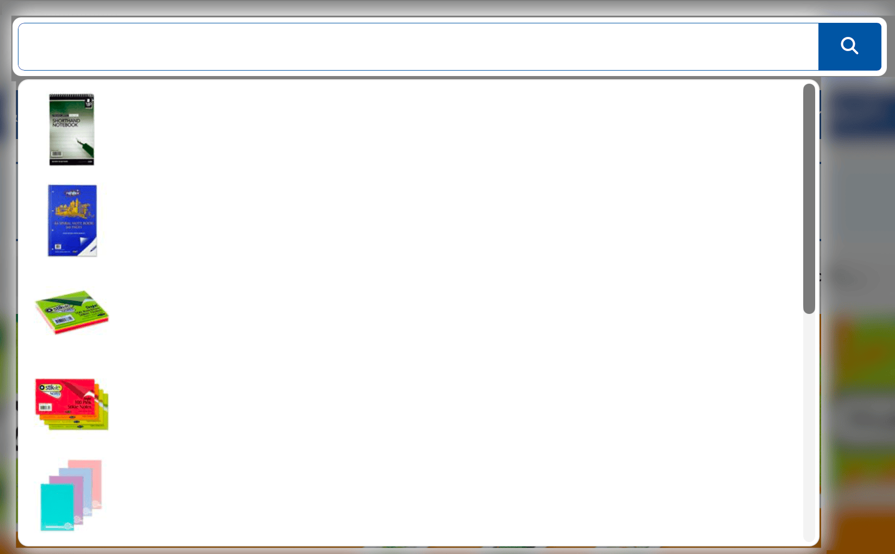
www.premio.ie​
Premio AI Search
Zero effort search tool
Automatically indexes based on Titles, Categories,
Refinements, Product Codes and Product Descriptions
Full ability to overwrite any of any search term
Ability to handle misspellings, synonyms
Rule engine to automate new products

Slide 8
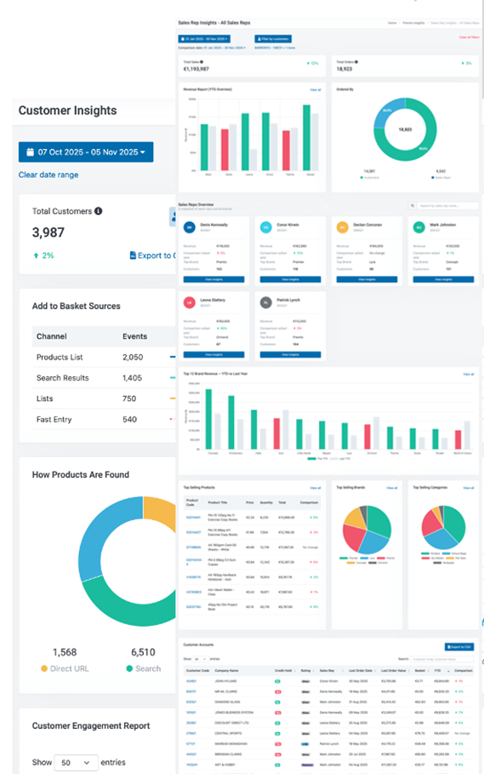
Premio Insights
Real-time analytics to keep on top of:
  Customers
  Products
  Orders
  User Interactions

Slide 9
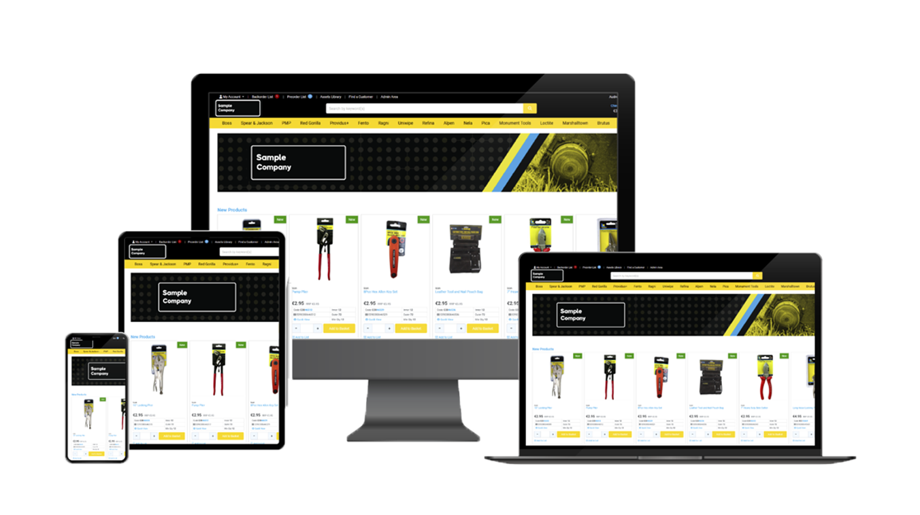

Slide 10
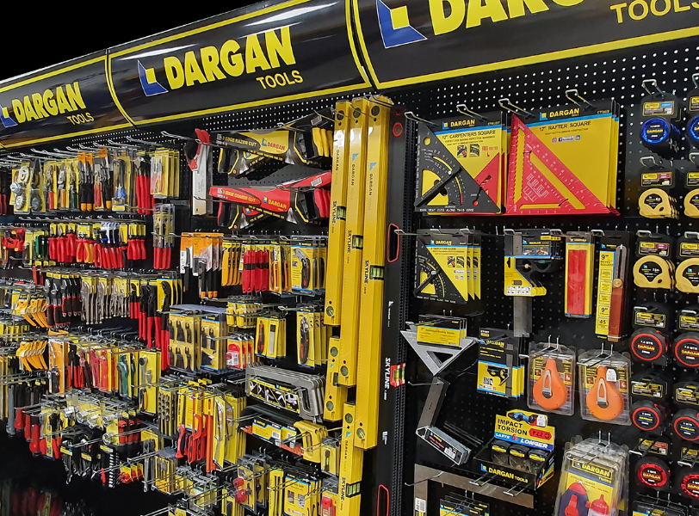
www.premio.ie​
Dargan Tools Ltd
Founded in 1981 by John Dargan Snr. – now a leading supplier to the Hardware, DIY, and Builders Merchant sector
Inventory & Facility: 40,000 sq ft warehouse in Carlow, stocking over 2,500 products
Own Brand: Ireland’s first “own brand” range of hand tools, recognised for quality
Exclusive Distribution: High-end construction and garden products, Boss range of chemical & cleaning products
Wide Range of Products: Carpentry, Cleaning, Concreting, Cutting, Drilling, Fixing, Gardening, Measuring, Plumbing, Safety & Storage

Slide 11
www.premio.ie​
Why Dargan Tools Choose Premio: Partnership & Implementation
We needed a B2B eCommerce solution that could integrate with our Intact ERP and handle real‑time pricing, stock and product updates.
Premio delivered real‑time product, pricing & stock synchronisation; self‑service ordering 24/7; automated catalogues; end‑to‑end quoting to checkout.
Premio Implementation included workflow mapping, systems integration, platform configuration, staff training and go‑live with feedback loops and ongoing support.

Slide 12
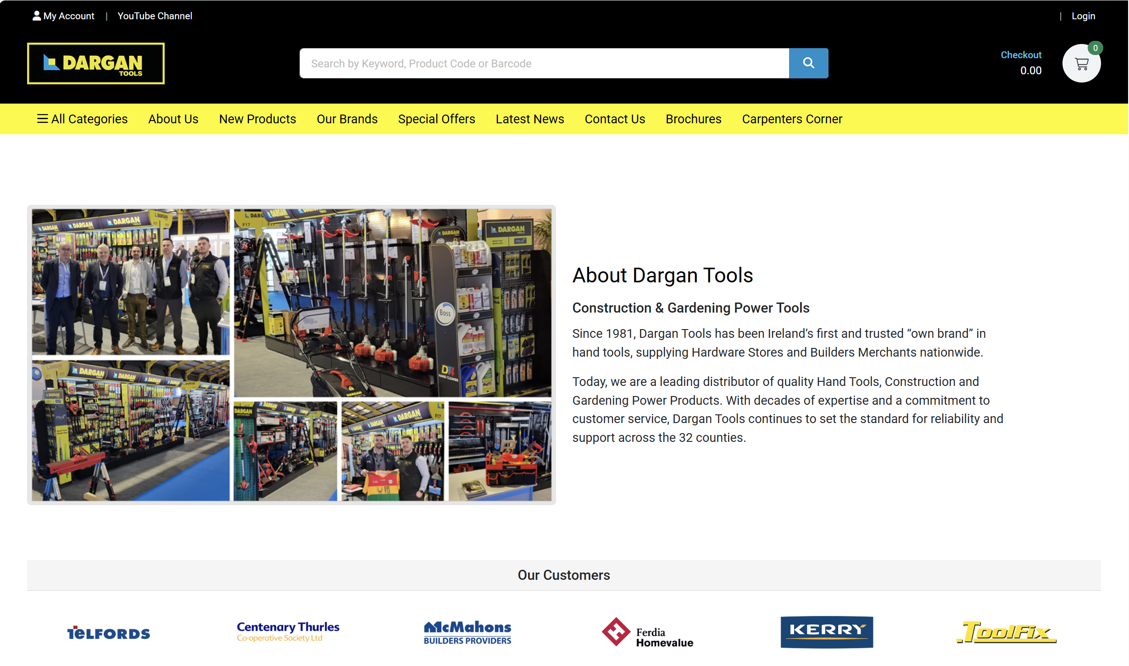
www.premio.ie​
Premio Platform in Action: How it’s Used Day-to-Day
Our trade customers now have self‑service access any time, and our team has a central platform for ordering and re‑ordering.
Thanks to Intact‑Premio integration, stock and pricing information is live — reducing errors and delays.
Catalogue updates and promotions are automated, ensuring customers see the latest selections instantly.

Slide 13
www.premio.ie​
Tangible Results: Key Benefits & Outcomes
Customers now get instant access to products, pricing and stock.
We’re processing orders 24/7 rather than being constrained to office hours.
Staff time spent on administration has dropped, allowing more focus on customer service.
Processes are now scalable, supporting business growth without proportional headcount increases.

Slide 14
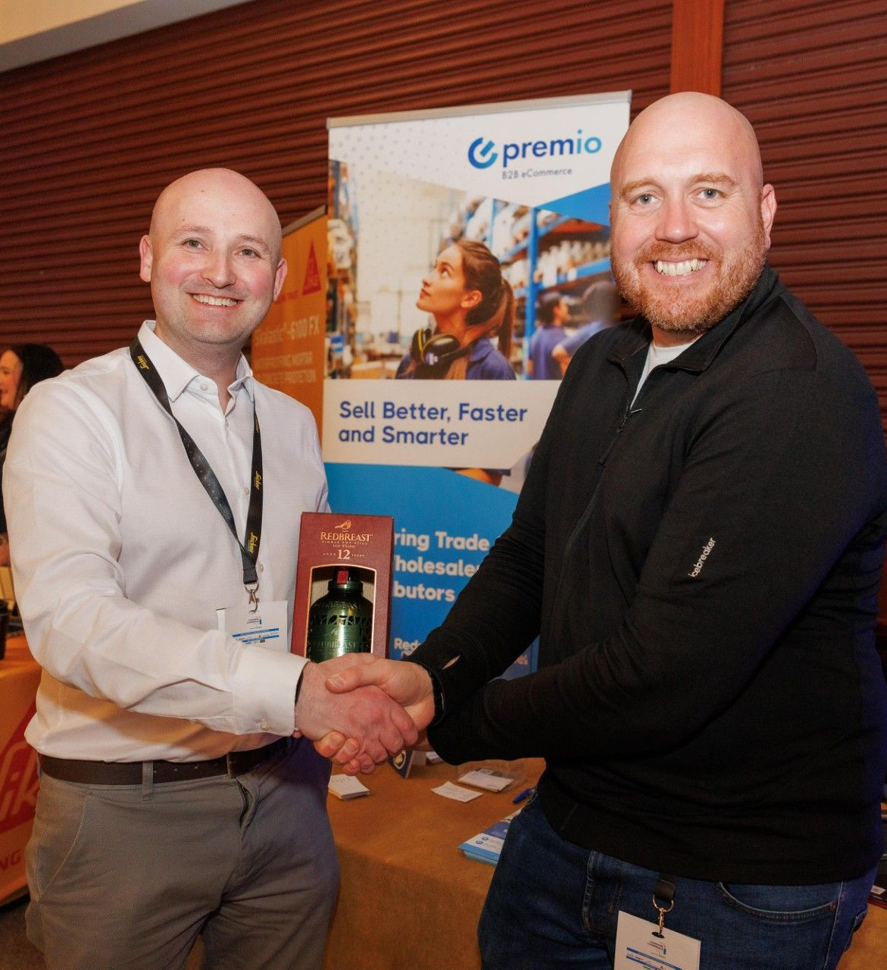
www.premio.ie​
The Human Partnership – Collaboration & Support
Premio works closely with clients to map workflows and optimise processes
Ongoing support ensures smooth day-to-day operations
Tailored solutions for each customer, recognising that every workflow is slightly different
Partnership approach fosters long-term business growth

Slide 15
www.premio.ie​
Premio Roadmap & Innovation
Continuous platform enhancements and feature updates
Integration with new technologies to support growing client needs
Focus on improving user experience and operational efficiency
Innovation tailored to the B2B wholesaler/distributor sector

Slide 16

Premio powers Irish wholesalers and distributors to sell smarter and faster.
www.premio.ie ​

Slide 17
www.premio.ie​
THANK YOU​
Contact us:
info@premio.ie
+353 (0)21 245 5022

